Slide 1



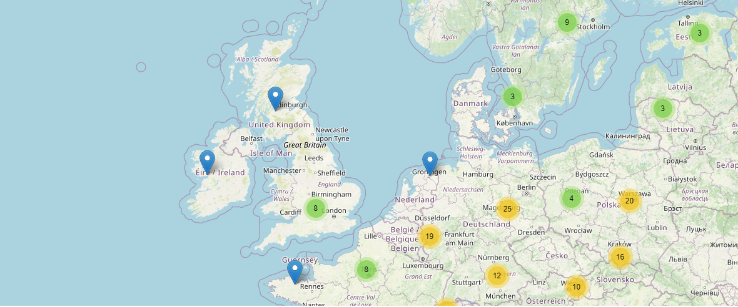




Presentation of Studies of the Ukrainian Science Diaspora Initiative
November 27, 2025

Slide 2
Agenda (CET)
14:00 – 14:05 Greetings (GIZ, MESU, Co-founders of the Initiative “Ukrainian Science Diaspora”)
14:05 - 14:25 Presentation of Research “Impact Assessment of the Ukrainian Science Diaspora on the Rebuilding of Ukraine” and a complementary study on the experiences, challenges, and prospects of Ukrainian scientists temporarily or permanently residing abroad.
Speakers: Prof. Yevheniia Polishchuk, Oleksandr Pozniy .
14:25 -14:40 Open Discussion
14:40 -15:10 Presentation of the Interview Series: Ukrainian Scientists Abroad: Scientific Diplomacy and Activism.
Speaker: Prof. Ihor Lyman
15:10 – 15:30 Open Discussion and Conclusions

Slide 3
IMPACT ASSESSMENT
OF THE UKRAINIAN SCIENCE DIASPORA
ON REBUILDING
THE RESEARCH AND HIGHER EDUCATION SYSTEM OF UKRAINE
Prof.Yevheniia Polishchuk, Oleksandr Pozniy

Slide 4
Methodology
Objective: to assess the contribution of the Ukrainian scientific diaspora to the restoration of science and education, to identify barriers, incentives, and mechanisms for sustainable engagement.
Method: online survey (CAWI) of Ukrainian scientists abroad.
Sample: non-statistical combined (network recruiting, snowball sampling, open databases).
Number of respondents: 300 from different countries, fields of science, and migration statuses.
Data collection took place from October 23 to November 25, 2025.
Tool: structured questionnaire — engagement, cooperation, academic capital, willingness to return, vision of the role of the diaspora.
Analysis: quantitative (SPSS) and qualitative (content analysis) methods; triangulation principle.
Ethics: voluntary participation, anonymity, GDPR compliance.
Expected outcome: analytical basis for state and university policies on cooperation with the scientific diaspora, development of the Ukrainian Scientific Diaspora Platform.

Slide 5

















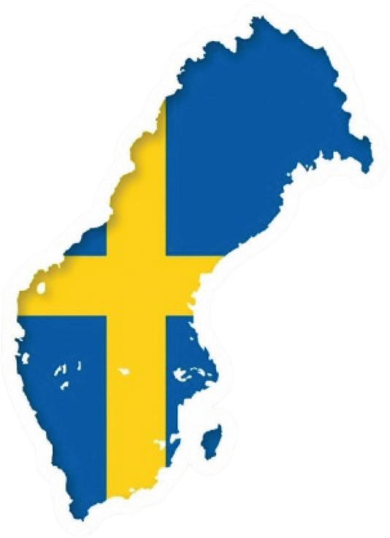



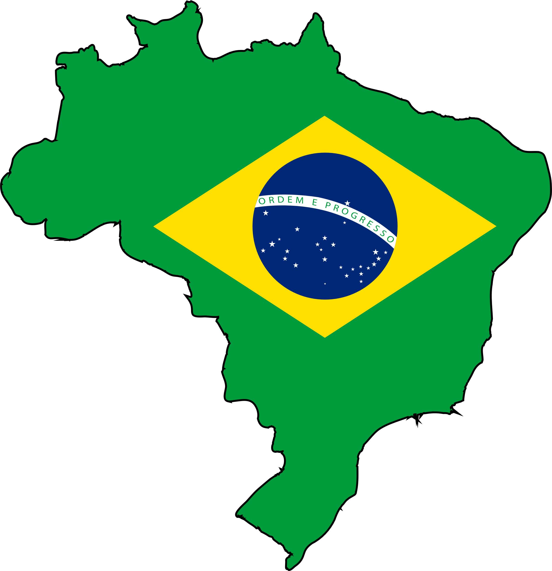




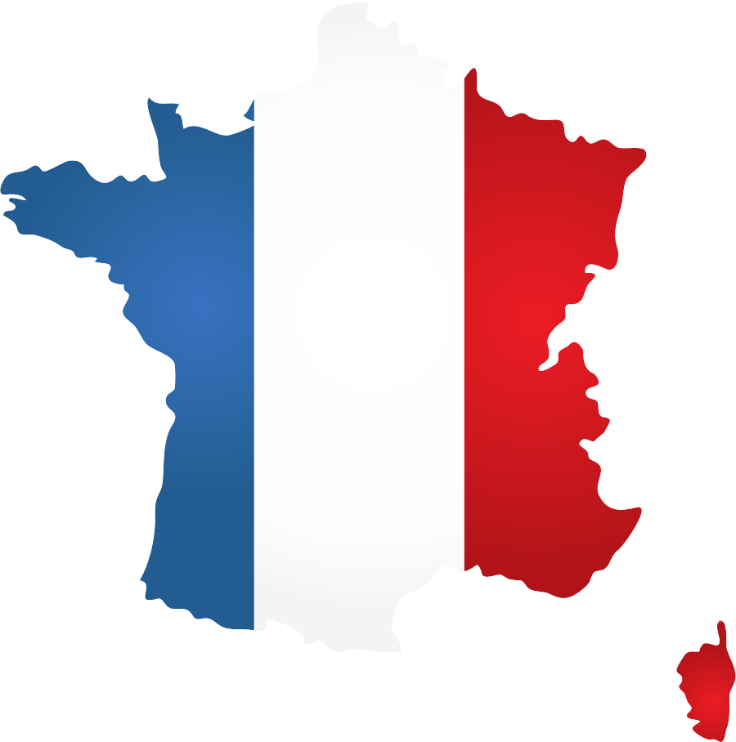




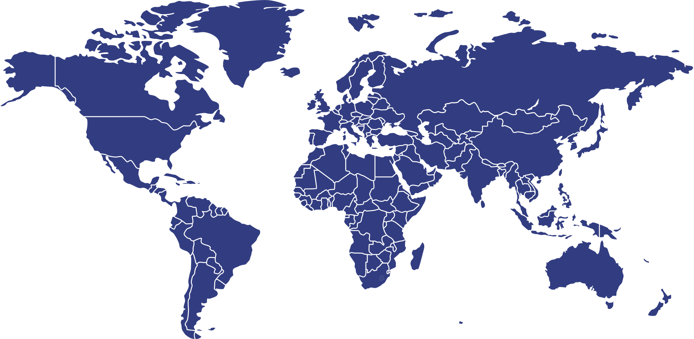

Profile of the science diaspora respondents
Country of residence
Gender
Left Ukraine
Level of education
22%
13.7 %
34%
66%
Bachelor's degree
Master's degree
Germany
Poland
Before
February
2022
After
February
2022
PhD
4,7%
74%
25%
Doctor of Science
8,7%
Other
United Kingdom
USA
Age
Field of science
4,3%
4%
18-29
Social sciences
36,7%
Medical and health sciences
4,7%
Switzerland
Austria
30-39
Natural sciences
19,7%
40-49
Engineering and technology
11,3%
3,7%
50-59
Humanities
23,3%
3%
60-69
Agricultural sciences
2,7%
Other
1,7%
Finland
Sweden
70+
3%
3%
Current professional status abroad
Brazil
Spain
I work for a foreign academic institution (temporarily)
I work for an NGO
3%
2%
I work remotely for a Ukrainian institution
I work for a private company
France
Italy
I am currently unemployed
I work for a foreign academic institution (permanently)
I work for a think tank
26,1%
I receive a scholarship/grant
I am retired
Other

Slide 6









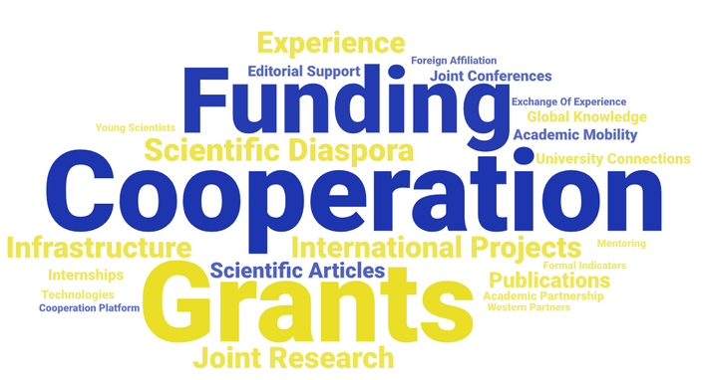
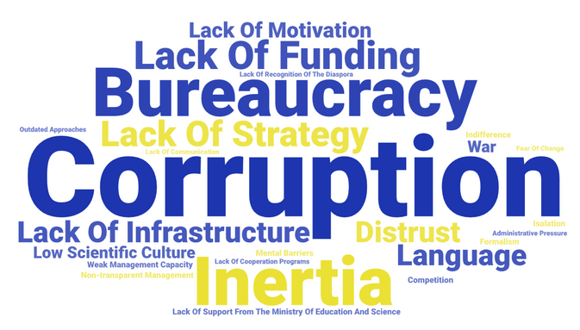


Participation of the diaspora in activities supporting Ukraine
Activities to support Ukraine
91,3%
Yes (regularly and occasionally)
Forms of cooperation with Ukrainian institutions
Joint scientific publications
Stakeholders' interest in cooperation with the scientific diaspora
Very interested
Participation in conferences, workshops, or seminars organized in Ukraine
Somewhat interested
Not very interested
Not interested
Promotion of Ukrainian science and culture abroad (speeches, public events)
Difficult to answer
Teaching/giving lectures online
Joint preparation of grant applications
Scientific consulting for Ukrainian students/graduate students/young scientists
Reasons for interest
Reasons for lack of interest
Joint research projects
Expert evaluation/review of scientific works or projects
Charitable or volunteer support for scientific, educational, and other initiatives
Countering disinformation and propaganda from the Russian Federation

Slide 7













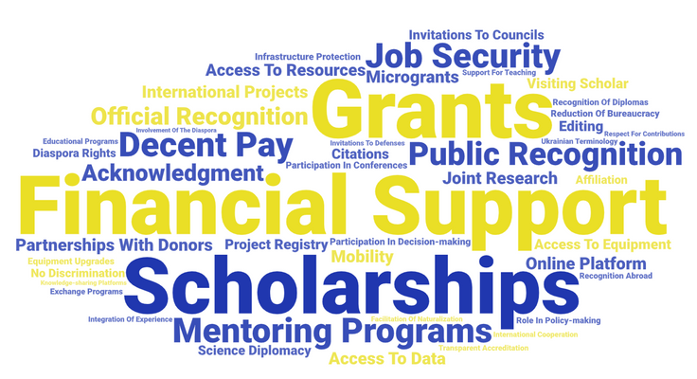




Engagement and barriers to participation
Willingness to participate in projects for the rebuilding of Ukraine
93%
Involvement in projects outside Ukraine
45.5%
Yes /
Most likely yes
Yes
Mechanisms for encouraging and determining contributions to Ukraine’s rebuilding
Obstacles to active contribution to Ukraine’s rebuilding engagement
Invitations to participate in joint international research programs in Ukraine
Poor communication between Ukrainian institutions and scientists abroad
Invitations to join advisory and strategic scientific councils at government agencies
Lack of funding/instability of financial programs
Invitations to participate as keynote speakers at scientific conferences and forums
Lack of clear state mechanisms for engaging the diaspora
Provision of special scholarships or diaspora support funds
Insufficient motivation on the part of Ukrainian institutions (recognition, encouragement, rewards)
Invitations to join supervisory boards of universities and research institutions
Invitations to join supervisory boards of universities and scientific institutions
Bureaucratic obstacles
Official distinctions, prizes, and awards from Ukrainian institutions at various levels
Limited time due to professional or family commitments
Lack of recognition or underestimation of the achievements of Ukrainian scientists abroad
Other mechanisms for encouraging and determining contributions to Ukraine's recovery
Lack of a single coordination platform for cooperation
Lack of modern infrastructure in Ukrainian institutions (laboratories, equipment, databases)
Difficulty accessing information about opportunities for participation

Slide 8

















Support, awareness, and motivation
The need for a program to support the Ukrainian science diaspora
Level of awareness of opportunities for cooperation with Ukrainian colleagues
Yes, definitely
High
Yes, but in partnership with international donors
Medium
Possibly, depending on funding
Low
No
Incentives that could increase interest in cooperation with Ukraine
Involvement in shaping Ukraine's scientific policy and development strategies
Opportunity to participate in joint international projects supported by Ukraine
Opportunity to participate in joint international projects supported by Ukraine
Involvement in shaping Ukraine's scientific policy and development strategies
Before
February
2022
Financial remuneration
Financial remuneration
Support for mobility (business trips, visits, conferences)
Support for mobility (business trips, visits, conferences)
Opportunity for career growth/advancement in academia
Opportunity to participate in joint international projects supported by Ukraine
Publication opportunities in Ukrainian and international journals
After
February
2022
Financial remuneration
Recognition of cooperation results (awards, certificates)
Involvement in shaping Ukraine's scientific policy and development strategies
Access to Ukrainian research infrastructures (laboratories, data, archives)
Support for mobility (business trips, visits, conferences)

Slide 9
Problem. Weak communication between the scientists in diaspora and in scientists in Ukraine
Recommendations:
For scientists in diaspora:
For scientists in Ukraine:
For universities and research labs in Ukraine:
To be proactive and ask the Ukrainian universities and colleagues about their challenges and needs. Remember, a war is currently ongoing in Ukraine, and they are busy with another kind of routine.
To join different activities related to science diaspora engagement (mentorship programs, online presentations, etc.)
To use the www.ukrdiaspora.nauka.gov.ua platform for searching contacts and participating in the mentorship program, learn more about the benefits of diaspora cooperation.
To work and establish connections with alumni who are considered diaspora scientists. Additionally, paying attention to the administrative staff can facilitate various connections and open new horizons for collaboration.
To prepare reports on the needs and problems of universities and laboratories, and to publicize information.
To develop a mechanism of saying “Goodbye” and “Thank you” for those who left Ukraine after 2022 because of the war. They are the next generation of the Ukrainian science diaspora.
To provide opportunities to continue the affiliation with the Ukrainian university (digital ambassadors, scientific volunteers, academic attachés, research liaisons, honorary researchers, knowledge partners, etc.).
For the Ministry of Education and Science in Ukraine and other Ministries (related to the field of expertise):
To transform the Ukrainian Science diaspora initiative into a coordination centre with the diaspora.
To create an advisory body under the Ministry of Education and Science of Ukraine and other Ministries (related to the field of expertise)/or to invite them to working groups, which would include scientists from the diaspora who would directly participate in the process of forming policies in the field of science, higher education, and innovations.
To promote the importance of the diaspora scientists' engagement in different activities, including in their digests for scientists' information from the science diaspora community.
For NGOs and other communities that represent different communities of scientists in Ukraine:
To use the power of the network and become a hub for hosting the Ukrainian scientists in diaspora with speeches, presentations, etc. The network effect will multiply the impact of diaspora scholars and bringing new values in academic society.

Slide 10
Problem: Lack of programs supporting joint science diaspora and home country scientists' initiatives
Recommendations:
For the Ministry of Education and Science in Ukraine, the National Research Fund of Ukraine, the Science Committee, Verkhovna Rada Committee of Education, Science, and Innovation, the President of Ukraine for Education, Science, and Sports Fund:
For Donors:
For National Research Fund of Ukraine:
To develop a seed funding program for establishing joint labs for scientists in diaspora and scientists in Ukraine
To introduce opportunities for joint management of scientific projects of diaspora scientists, those who are in Ukraine
To invite diaspora scientists as partners in consortia formed by the National Research Fund of Ukraine
To invite diaspora scientists as experts to review applications and develop recommendations for enhancing existing calls, and to reveal systematic problems of the Ukrainian scientists in the development of the project.
To develop programs of innovation development support with the engagement of diaspora scientists. The programs should be aligned with a new system of priorities in science and innovation (focus on defence, economy, and post-war development).
To develop programs for researchers returning to Ukraine temporarily.
To support development special research bilateral programs for researchers from Ukraine and from the diaspora (TOP-3 country candidates: Germany, Poland, United Kingdom) focused on rebuilding of Ukraine

Slide 11
Problem: Bureaucracy is a huge challenge to receive science in the diaspora support
Recommendations:
For universities and research labs in Ukraine:
For the Ministry of Education and Science in Ukraine
To provide the university of research institute regulations with the possibility of officially involving professors with foreign affiliations in co-teaching and co-research, and co-supervision of dissertations in the Ukrainian universities
To ensure the rapid recognition of degrees obtained at Western universities
To enable Ukrainian Universities to cover travel costs and facilitate money transfers abroad.

Slide 12
Problem: Weak rewarding mechanism at all levels
Recommendations:
For the Ministry of Education and Science in Ukraine,
the National Research Foundation of Ukraine, the Science Committee,
Verkhovna Rada Committee of Education, Science, and Innovation,
the President of Ukraine for Education, Science, and Sports Fund
For universities and research labs and NGO related to science and education and related to scientific expertise field in Ukraine
To use the existing mechanisms of rewarding actively (usually it is the gratitude or special reward for contribution to the University development),
To search, select, and nominate scientists who contributed to the rebuilding process for different existing rewards.
To establish special rewards
“For Contribution to Science Diplomacy”,
“Woman is Science Diaspora”,
“First Steps in Science Diplomacy” (for early career researchers) for prominent results

Slide 13
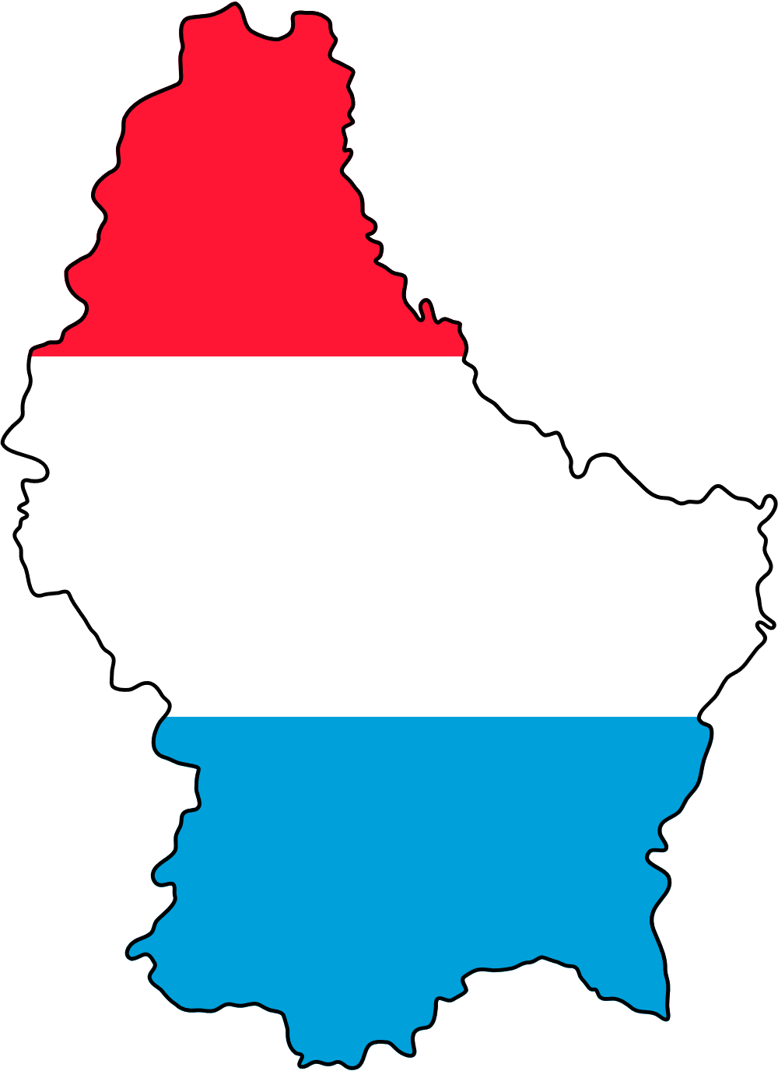
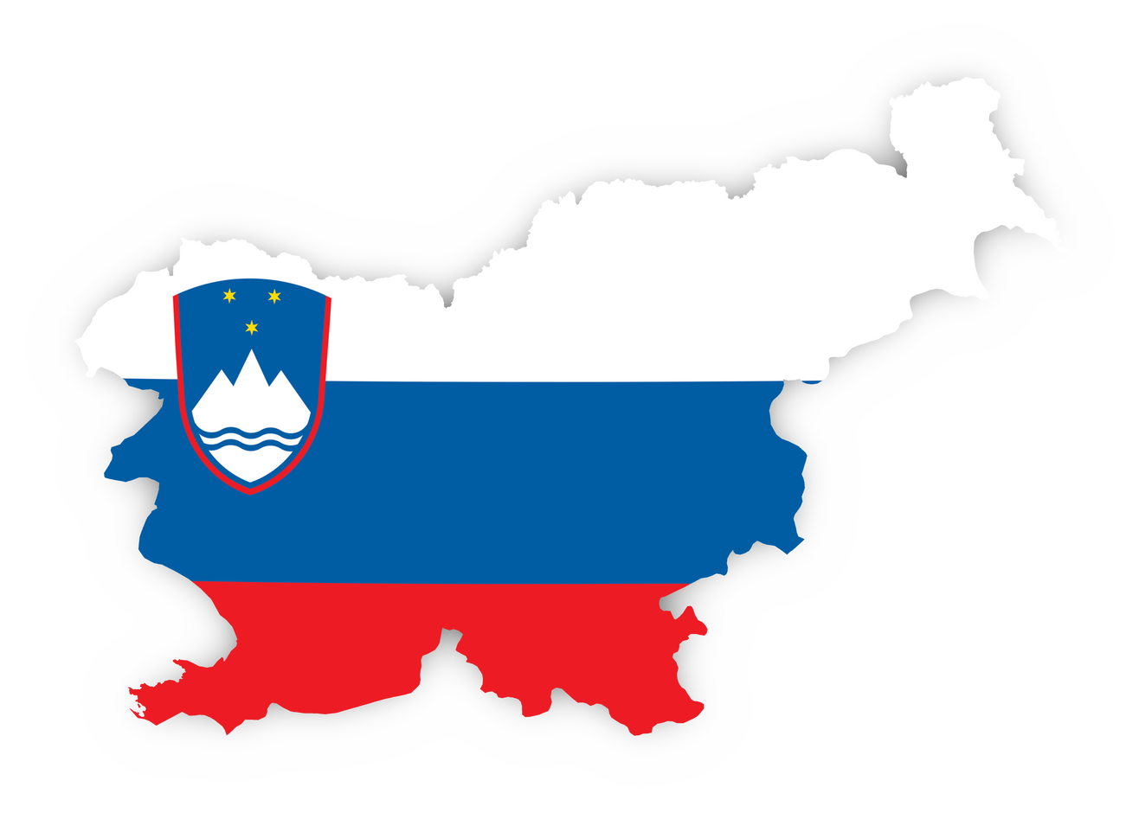
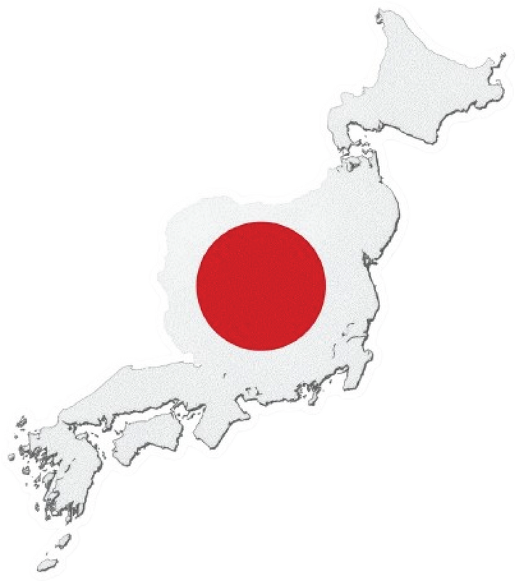
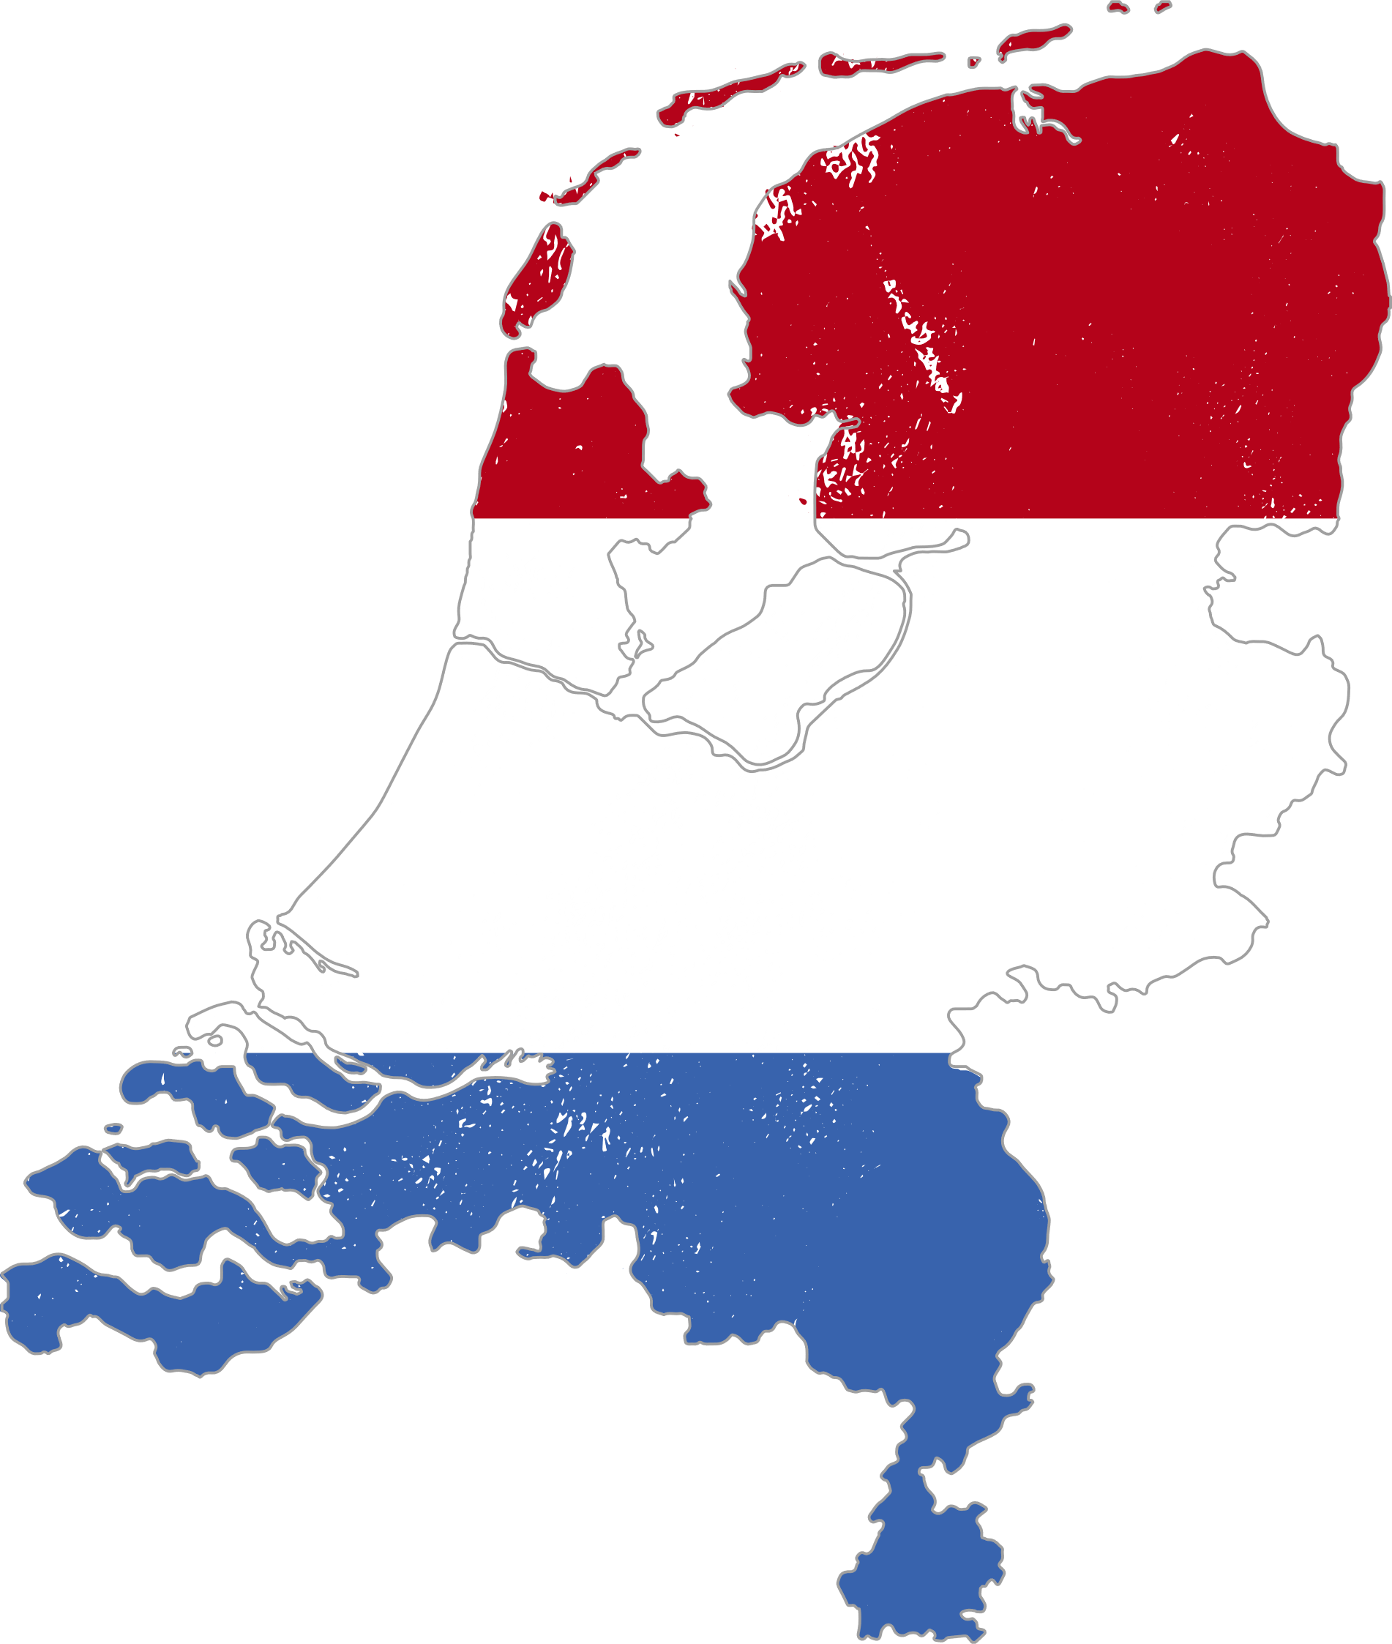





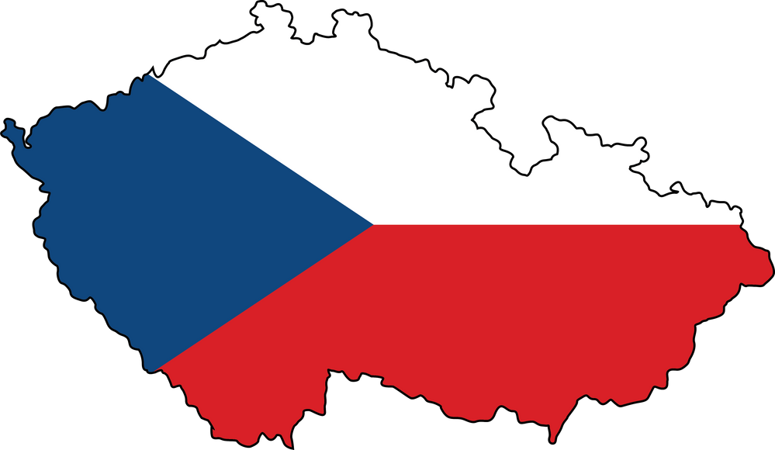

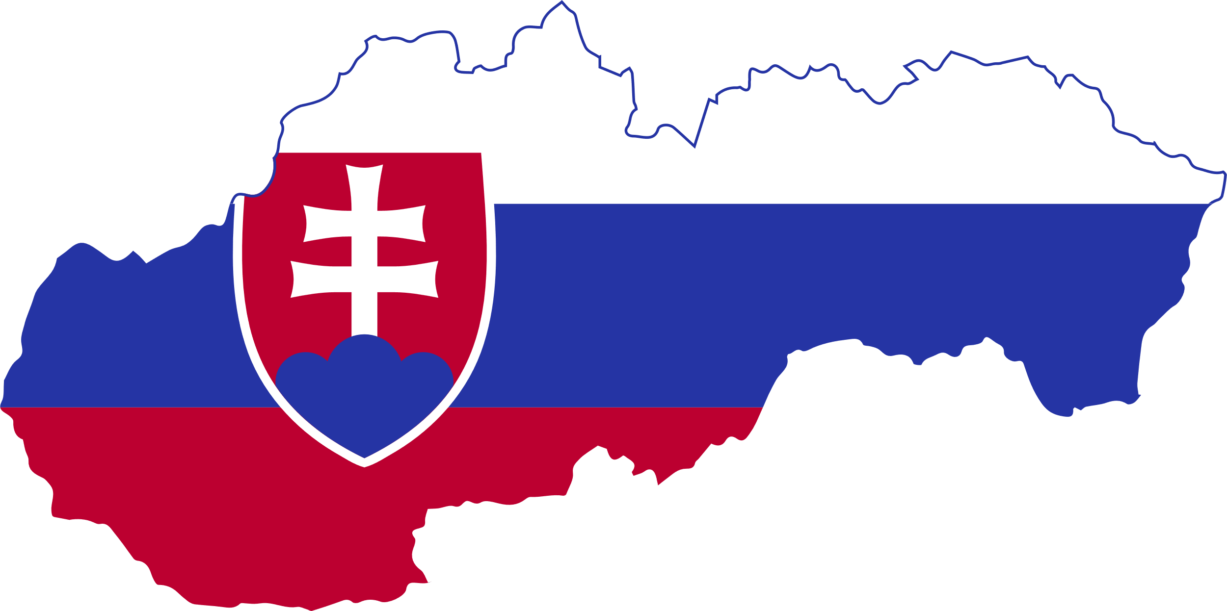
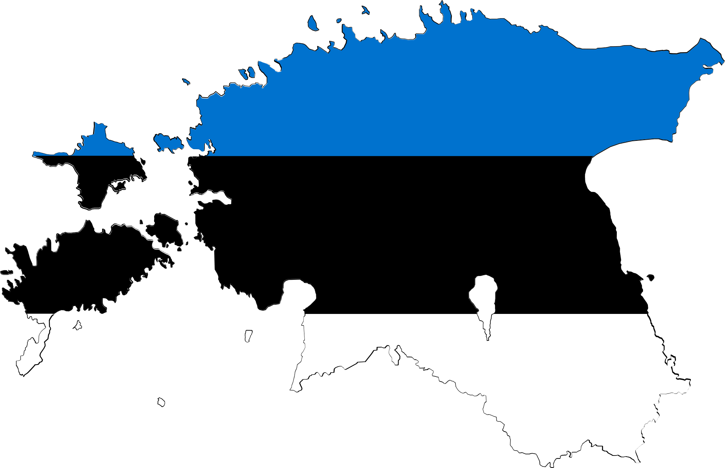
MAP OF EXPERT KNOWLEDGE OF THE SCIENCE DIASPORA
Social sciences
35
23
3
3
2
1
Germany
Spain
Switzerland
Luxembourg
Slovenia
Humanities sciences
26
12
3
3
1
1
Natural sciences
16
Poland
Netherlands
Sweden
Belgium
Japan
Engineering and technology
9
3
1
1
11
2
United Kingdom
USA
Brazil
Italy
New Zeland
Agricultural sciences
5
5
3
2
1
1
Medical and health sciences
2
Austria
France
Ireland
Portugal
Hungary
Other
2
5
3
1
2
1
Finland
Czech Republic
Canada
Slovak
Estonia

Slide 14
How digitalization can help to engage and promote scientists’ in diaspora support
Plans for the Development
of the Digital Platform “Ukrainian Science Diaspora”:
Engagement:
Promotion and further rewarding:
To develop a module for preparing petitions that can be signed by every Ukrainian scientist from the diaspora and beyond
To develop a module for submitting science diaspora’s projects for further promotion and using as a base for further rewarding

Slide 15
Conclusions:
1. Good science starts with talented people, good funding, and effective infrastructure (both research and institutional). The science diaspora can provide access to talented scholars, enhance access to funding, and contribute to the development of a cohesive research infrastructure.
2. It is necessary to distinguish between the scientific diaspora that was formed before 2022 and the one that is in the process of being formed after 2022. Accordingly, the potential of scientists abroad for the reconstruction of Ukraine is different. You should not expect much from those who left after 2022, but they have an extremely high motivation to cooperate.
3. Supporting the diaspora is not only the responsibility of Ukrainian scientists abroad. For diaspora assistance to be effective, it is necessary to be able to accept it. Therefore, it is the work of both sides.
4. Digitalization can intensify the work of the diaspora aimed at rebuilding Ukraine. It enables faster and more effective communication, conveying knowledge, and thus accelerating the processes of impact the rebuilding of Ukraine.
5. Diaspora assistance is valuable and should be properly evaluated. Both financial and non-financial incentives can be effective in this context. Developing a system of non-financial incentives is equally important and can be implemented at various levels.
6. The diaspora cannot solve all the problems of Ukrainian universities and research institutions, but it can significantly accelerate their internationalization, rebuilding, and integration to global research society.

Slide 16


OPEN DISCUSSION

